Slide 1
Sprocket Central Pty Ltd
-The Analytics Team
Data Insights & Presentation :

Slide 2

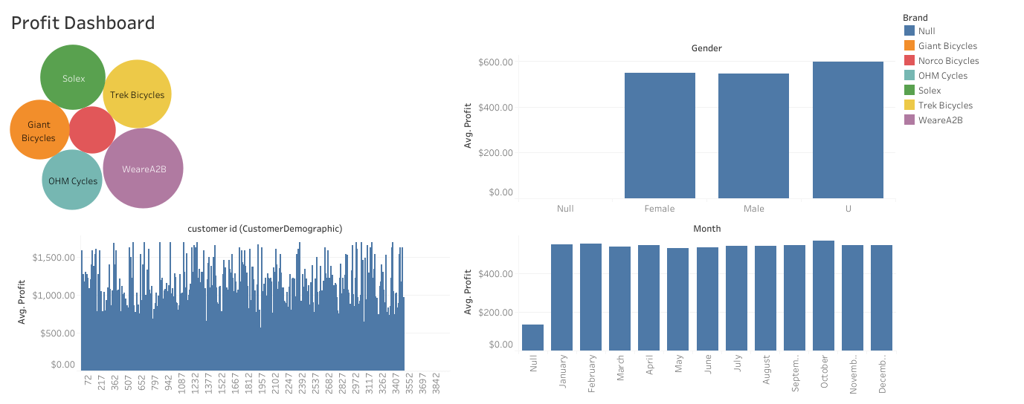

Slide 3
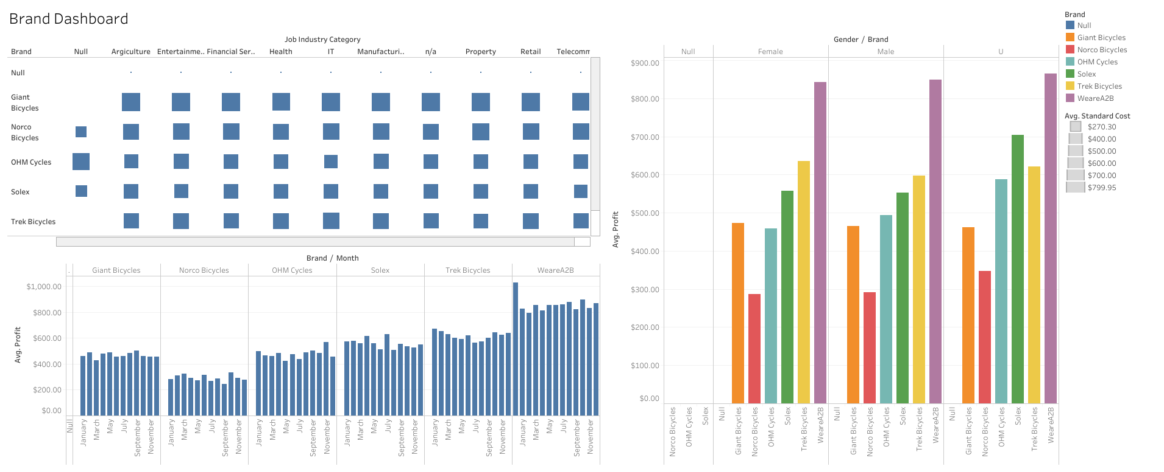

Slide 4
